Slide 1

EON AI VENTURES • PRODUCT EXPERIENCE
SYNTHETIC UI DEMONSTRATION
PermitIQ
The permit journey,
reimagined.
One UI screen per slide—showing how workers learn, prepare, review, verify, and improve a pump-seal job.
LEARN
PREPARE
REVIEW
VERIFY
IMPROVE
GENESIS-STYLE VISUAL WALKTHROUGH • OIL & GAS • JULY 2026

Slide 2

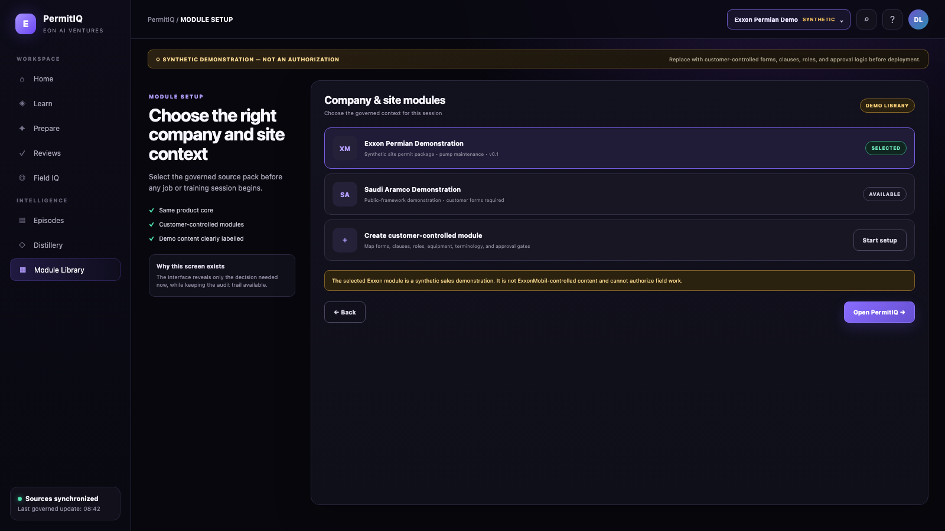
PERMITIQ UI WALKTHROUGH • SCREEN 01 OF 22
Start in the right governed world
ORIENT
SYNTHETIC UI DEMONSTRATION
Choose the company and site module before PermitIQ applies any forms, rules, roles, or vocabulary.
WHY IT MATTERS
The same trusted core can adapt to each company without mixing its controlled rules.
EON AI VENTURES • PERMITIQ UI CONCEPT
SYNTHETIC DEMONSTRATION — REPLACE WITH CUSTOMER-CONTROLLED FORMS & SOURCES
01 / 22

Slide 3

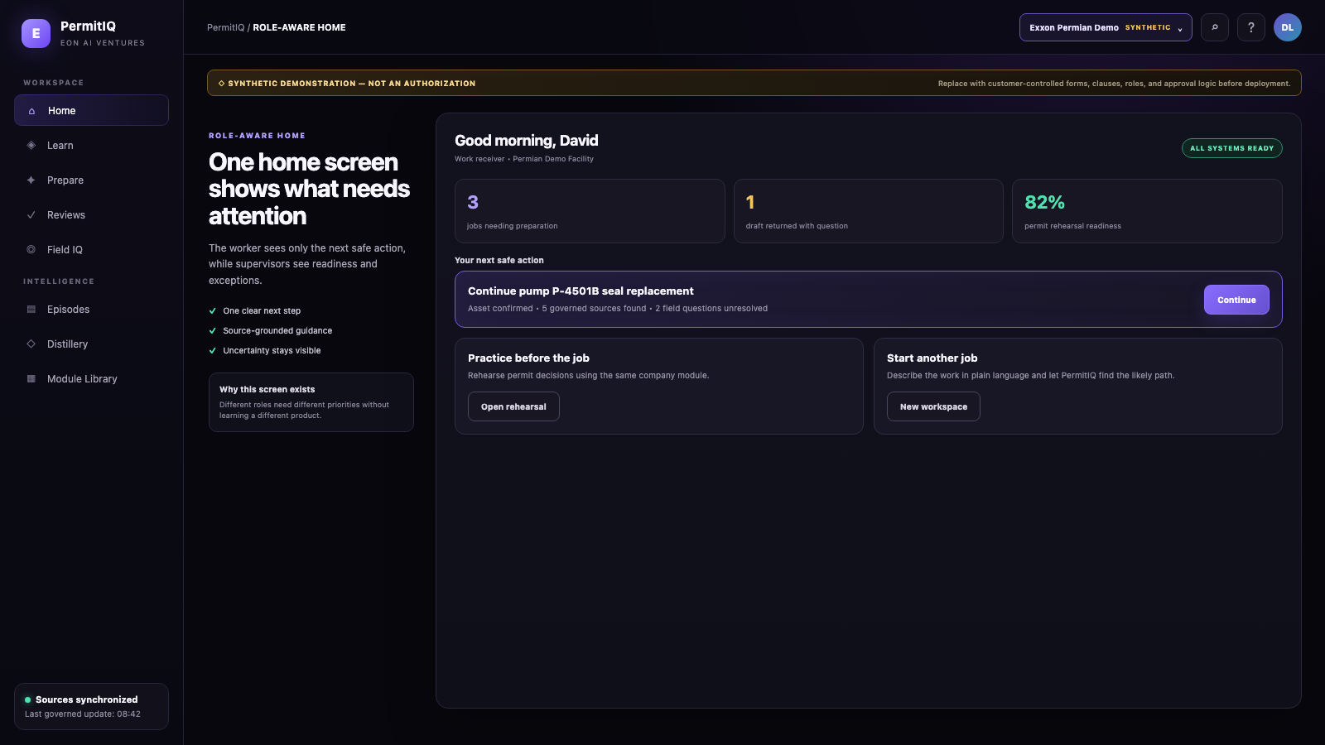
PERMITIQ UI WALKTHROUGH • SCREEN 02 OF 22
The next safe action is obvious
ORIENT
SYNTHETIC UI DEMONSTRATION
The home screen turns a complicated permit journey into one clear next step for the worker.
WHY IT MATTERS
Workers spend less time hunting and more time preparing the real job.
EON AI VENTURES • PERMITIQ UI CONCEPT
SYNTHETIC DEMONSTRATION — REPLACE WITH CUSTOMER-CONTROLLED FORMS & SOURCES
02 / 22

Slide 4
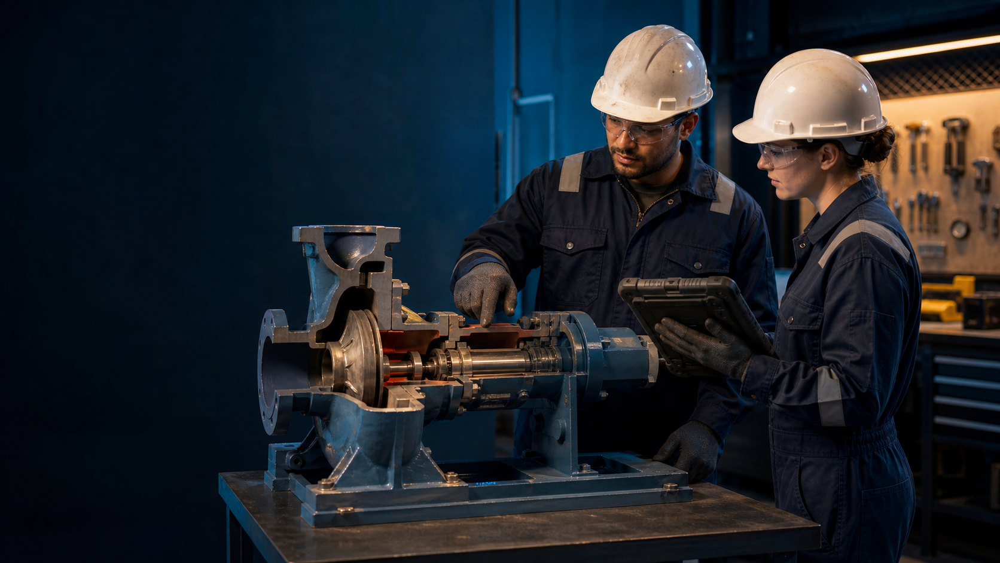
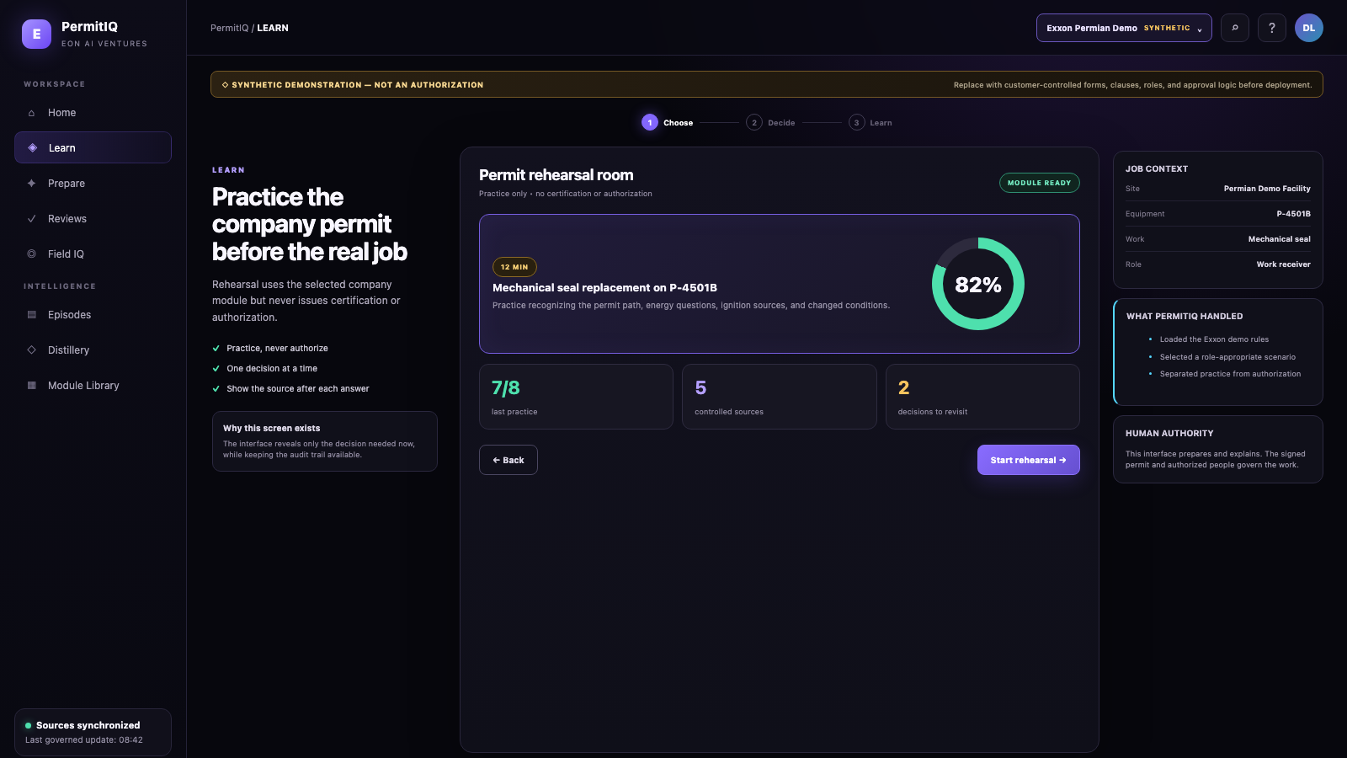
PERMITIQ UI WALKTHROUGH • SCREEN 03 OF 22
Practice the company’s permit before the real job
LEARN
SYNTHETIC UI DEMONSTRATION
Rehearse job decisions in a safe learning room built from controlled company sources.
WHY IT MATTERS
New and contractor personnel build confidence before the live permit process.
EON AI VENTURES • PERMITIQ UI CONCEPT
SYNTHETIC DEMONSTRATION — REPLACE WITH CUSTOMER-CONTROLLED FORMS & SOURCES
03 / 22

Slide 5

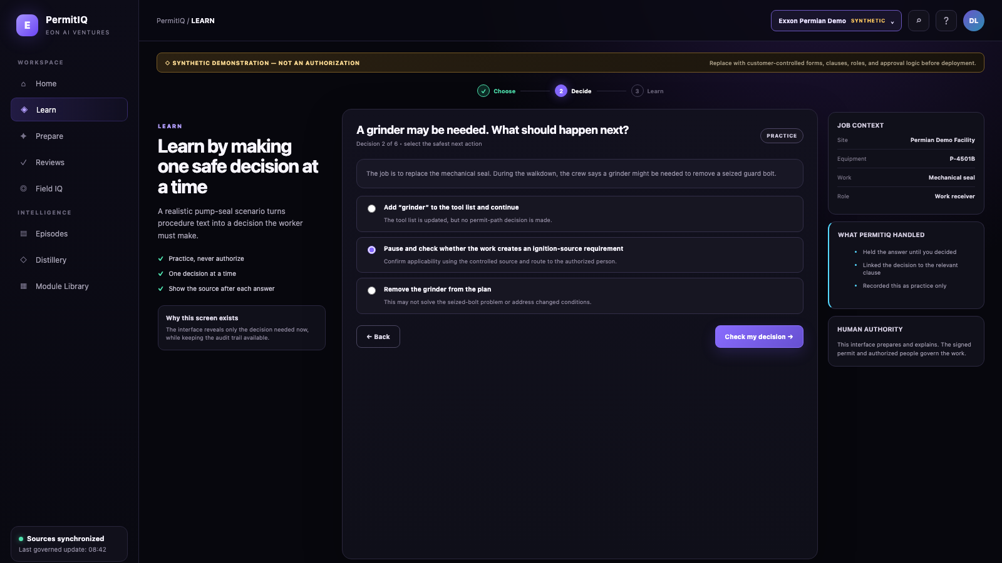
PERMITIQ UI WALKTHROUGH • SCREEN 04 OF 22
Learn by making one real decision at a time
LEARN
SYNTHETIC UI DEMONSTRATION
A pump-seal scenario asks what changed, which permit path may apply, and what must be checked.
WHY IT MATTERS
Workers understand why one tool or condition can change the job.
EON AI VENTURES • PERMITIQ UI CONCEPT
SYNTHETIC DEMONSTRATION — REPLACE WITH CUSTOMER-CONTROLLED FORMS & SOURCES
04 / 22

Slide 6

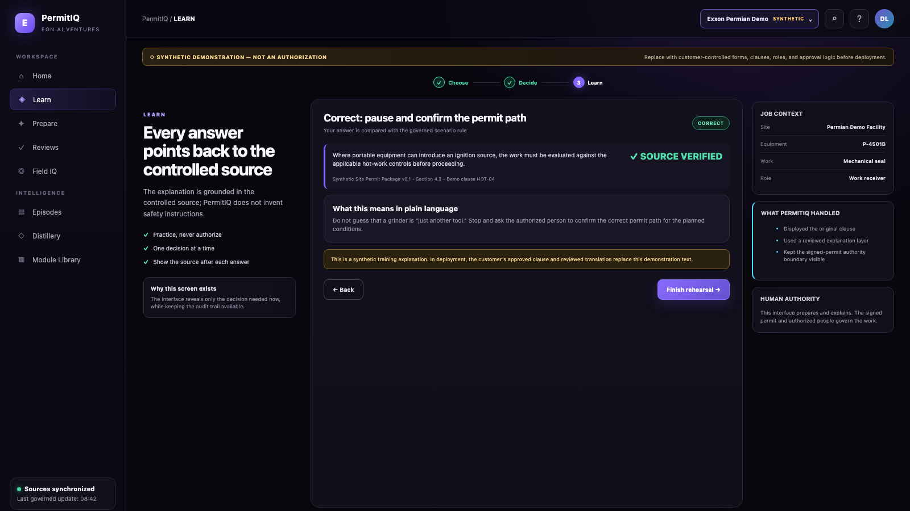
PERMITIQ UI WALKTHROUGH • SCREEN 05 OF 22
Every explanation points back to a source
LEARN
SYNTHETIC UI DEMONSTRATION
PermitIQ explains the answer and shows exactly which controlled clause supports it.
WHY IT MATTERS
The system teaches without inventing safety instructions.
EON AI VENTURES • PERMITIQ UI CONCEPT
SYNTHETIC DEMONSTRATION — REPLACE WITH CUSTOMER-CONTROLLED FORMS & SOURCES
05 / 22

Slide 7
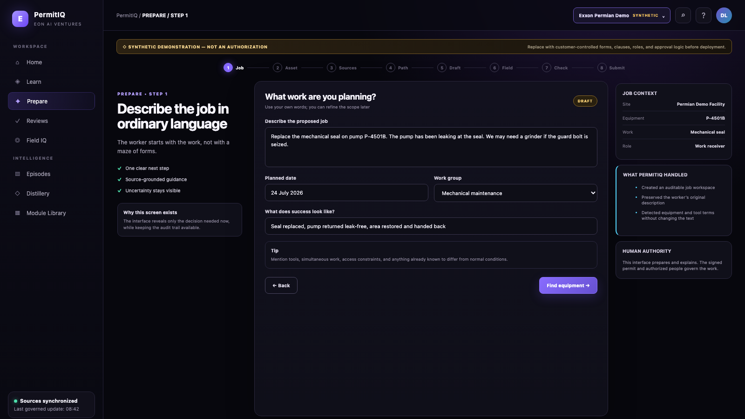

PERMITIQ UI WALKTHROUGH • SCREEN 06 OF 22
Start with the work—not the paperwork
PREPARE
SYNTHETIC UI DEMONSTRATION
Describe the pump-seal job in ordinary language before PermitIQ opens the company form.
WHY IT MATTERS
The package begins with clear job intent—not a wall of blank fields.
EON AI VENTURES • PERMITIQ UI CONCEPT
SYNTHETIC DEMONSTRATION — REPLACE WITH CUSTOMER-CONTROLLED FORMS & SOURCES
06 / 22

Slide 8
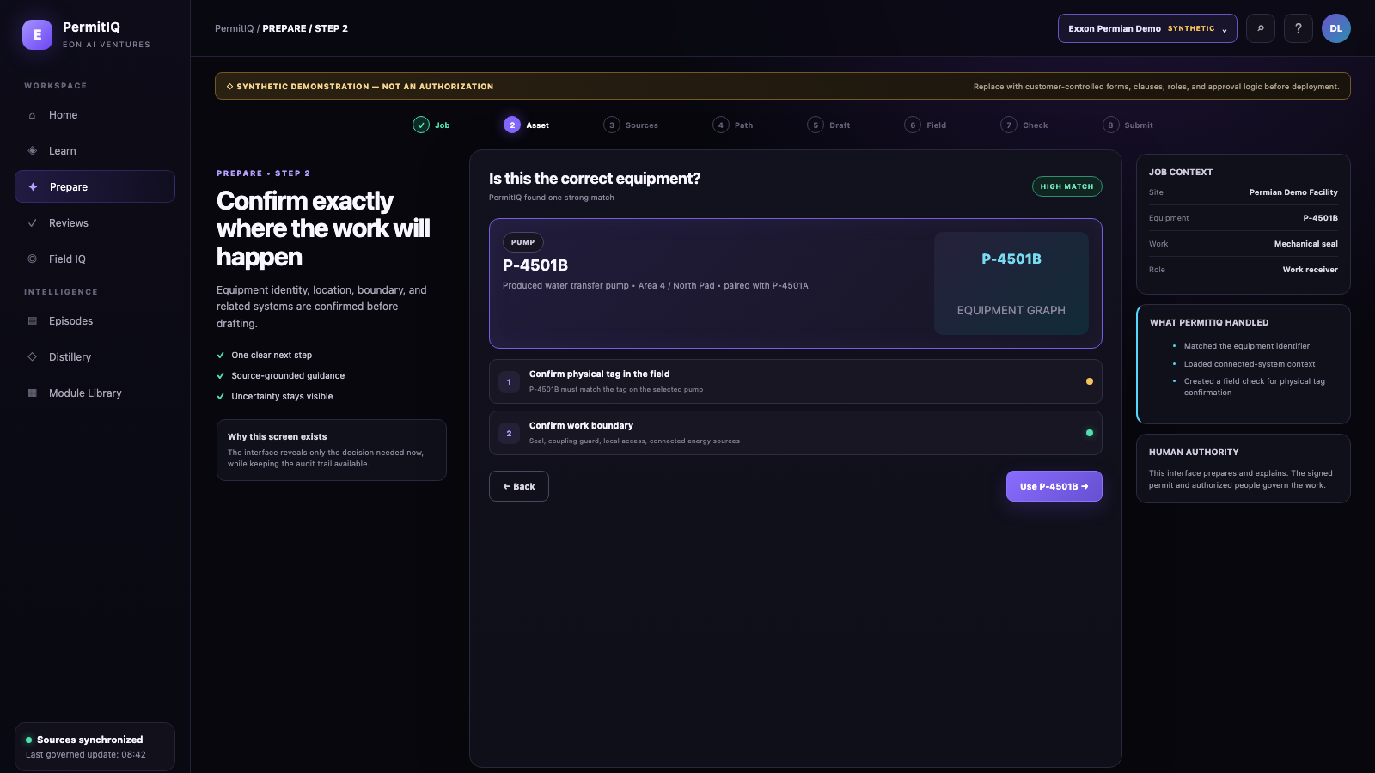
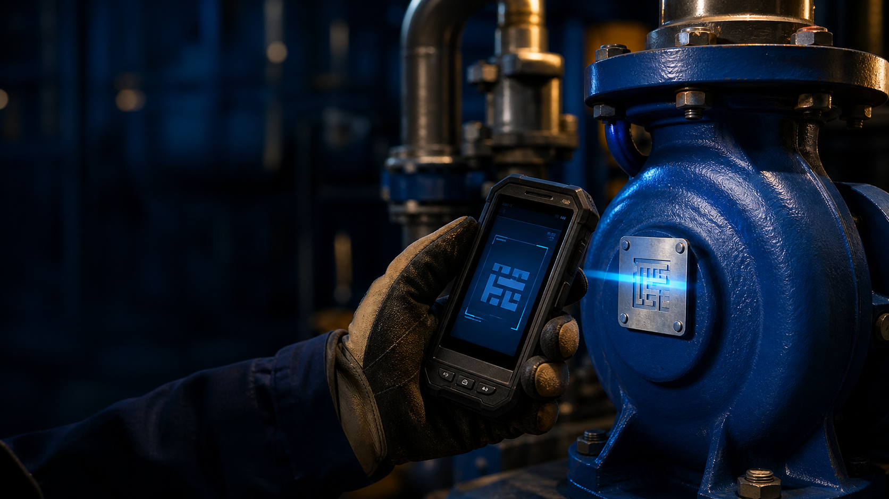
PERMITIQ UI WALKTHROUGH • SCREEN 07 OF 22
Confirm exactly where the work will happen
PREPARE
SYNTHETIC UI DEMONSTRATION
Select and verify the real equipment tag before the permit package can proceed.
WHY IT MATTERS
The right work on the wrong pump is still the wrong job.
EON AI VENTURES • PERMITIQ UI CONCEPT
SYNTHETIC DEMONSTRATION — REPLACE WITH CUSTOMER-CONTROLLED FORMS & SOURCES
07 / 22

Slide 9
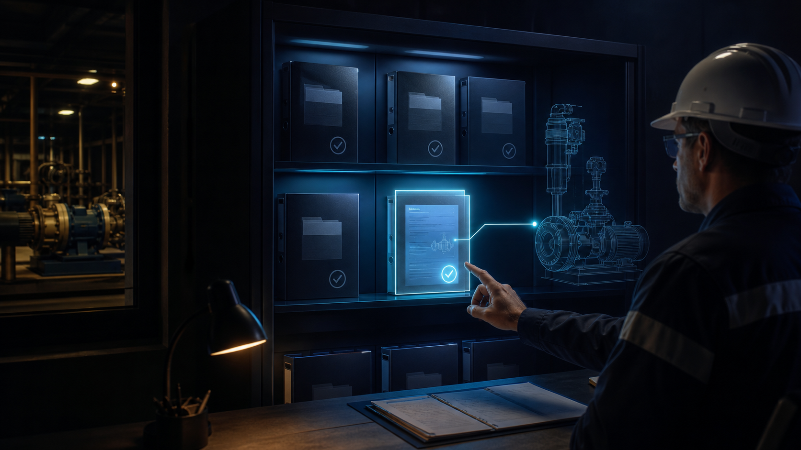
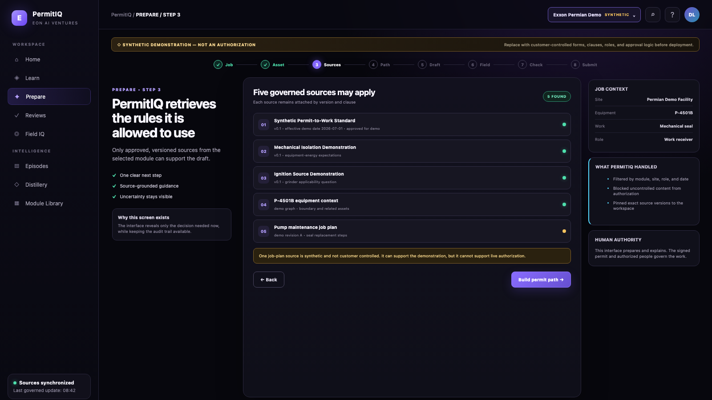
PERMITIQ UI WALKTHROUGH • SCREEN 08 OF 22
Only released sources are allowed to speak
PREPARE
SYNTHETIC UI DEMONSTRATION
Lock the draft to controlled documents released for this company, site, equipment, and task.
WHY IT MATTERS
Stale forms and uncontrolled PDFs cannot silently influence the answer.
EON AI VENTURES • PERMITIQ UI CONCEPT
SYNTHETIC DEMONSTRATION — REPLACE WITH CUSTOMER-CONTROLLED FORMS & SOURCES
08 / 22

Slide 10
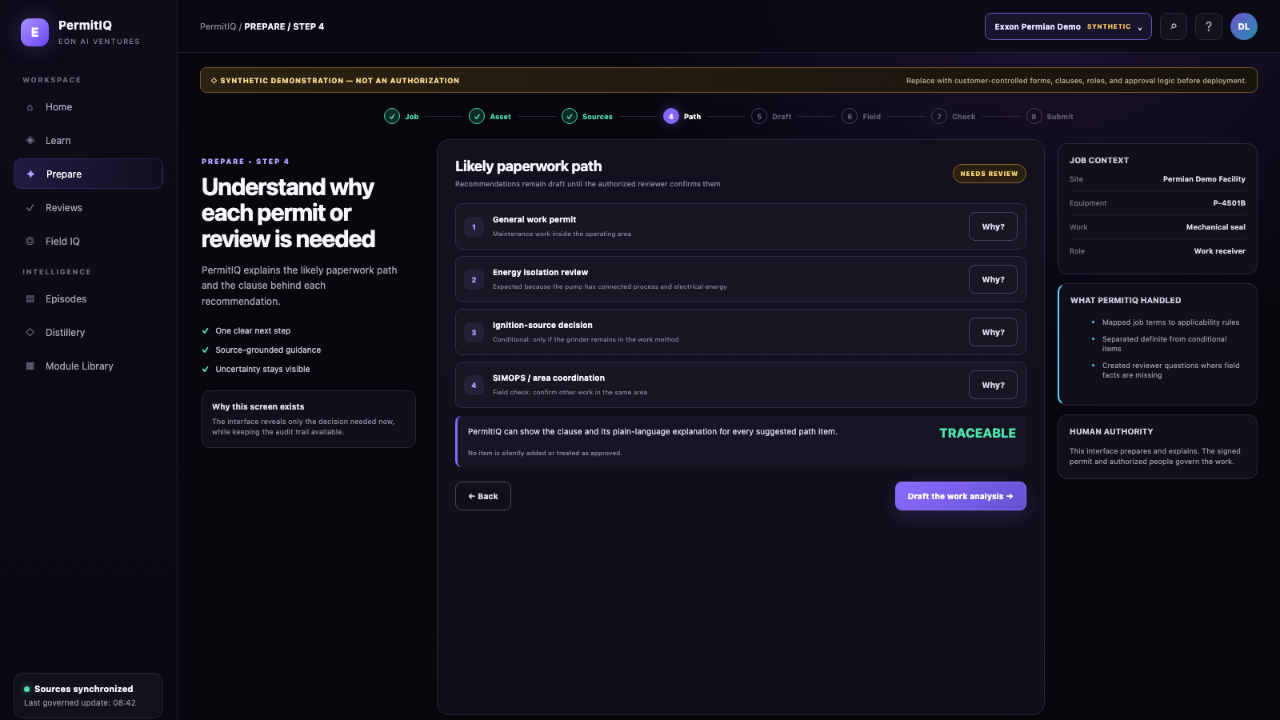
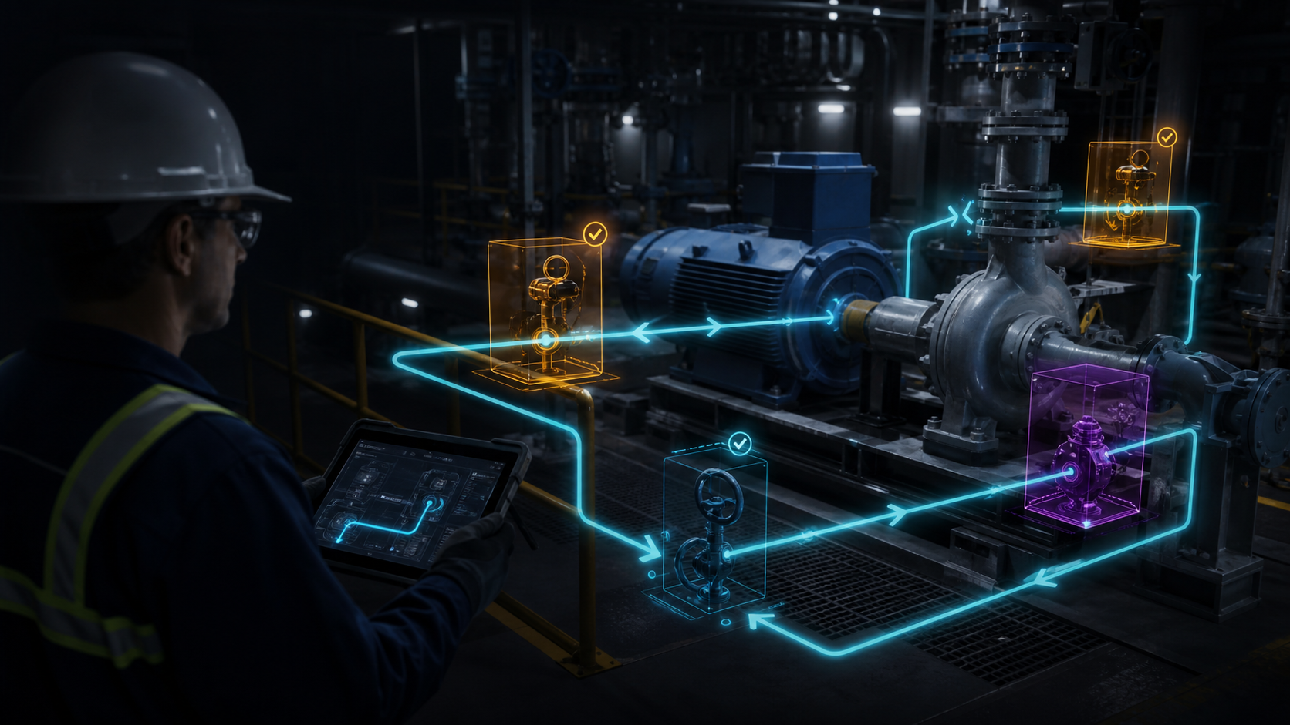
PERMITIQ UI WALKTHROUGH • SCREEN 09 OF 22
Show why each permit path is proposed
PREPARE
SYNTHETIC UI DEMONSTRATION
Map job facts to possible permit types and make every reason visible to the reviewer.
WHY IT MATTERS
The reasoning is visible, while the authorized human still decides.
EON AI VENTURES • PERMITIQ UI CONCEPT
SYNTHETIC DEMONSTRATION — REPLACE WITH CUSTOMER-CONTROLLED FORMS & SOURCES
09 / 22

Slide 11
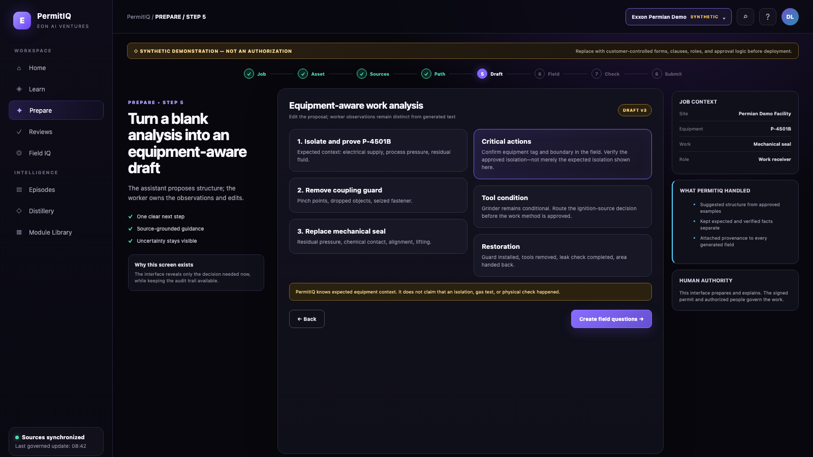

PERMITIQ UI WALKTHROUGH • SCREEN 10 OF 22
Turn a blank form into an equipment-aware draft
PREPARE
SYNTHETIC UI DEMONSTRATION
Map known pump hazards, isolations, and task conditions into the company’s own structure.
WHY IT MATTERS
Get a head start without pretending the field has already been checked.
EON AI VENTURES • PERMITIQ UI CONCEPT
SYNTHETIC DEMONSTRATION — REPLACE WITH CUSTOMER-CONTROLLED FORMS & SOURCES
10 / 22

Slide 12
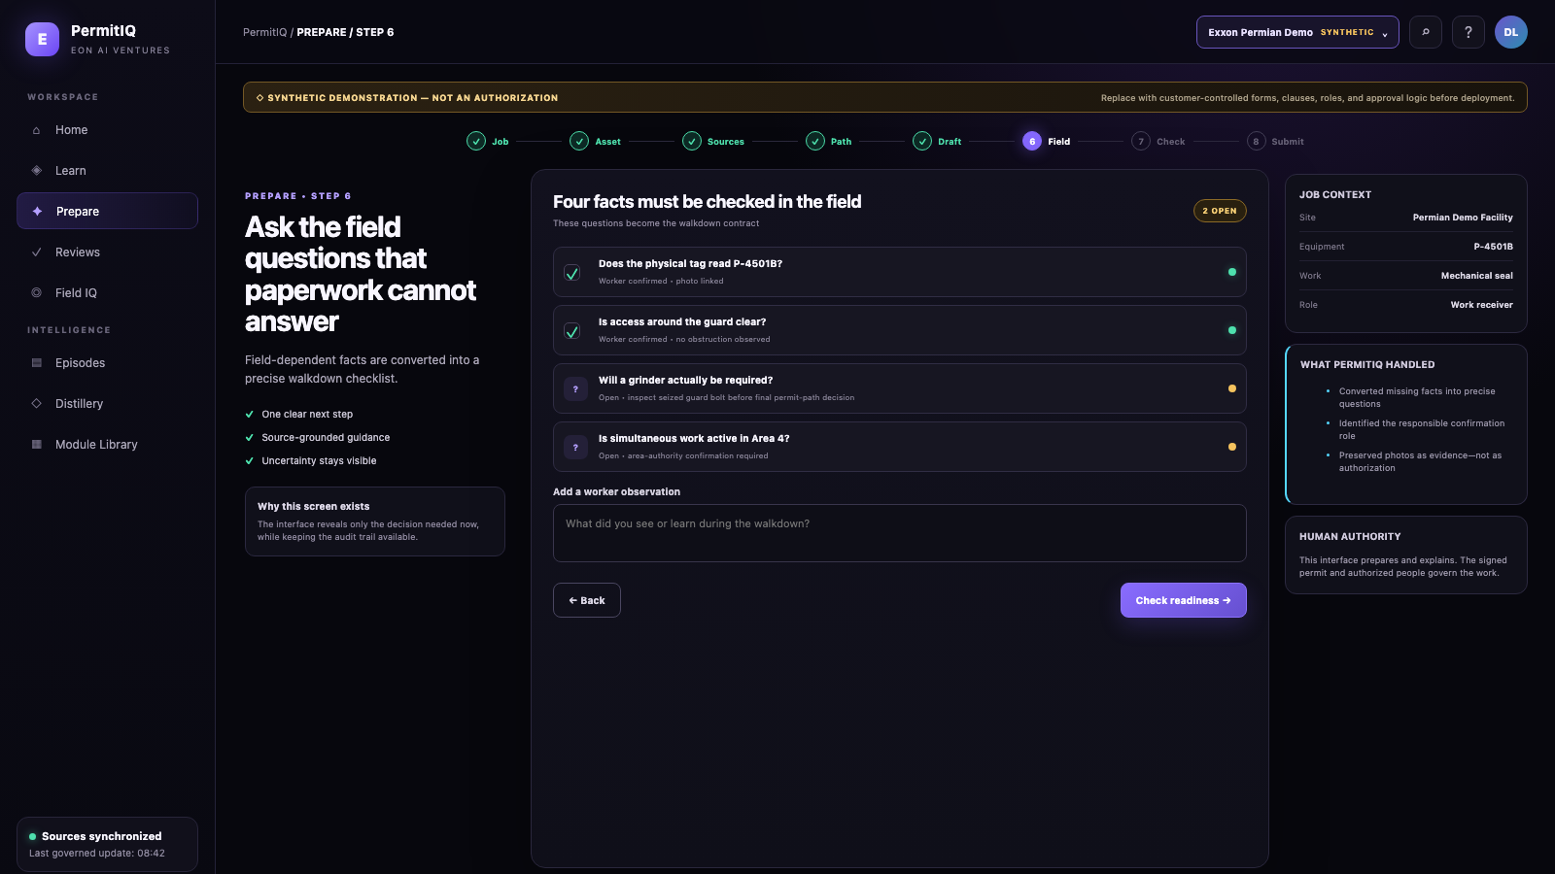

PERMITIQ UI WALKTHROUGH • SCREEN 11 OF 22
Paper cannot verify the field
PREPARE
SYNTHETIC UI DEMONSTRATION
Ask the worker to confirm the facts that controlled sources and software cannot know.
WHY IT MATTERS
Unknowns become explicit questions instead of hidden assumptions.
EON AI VENTURES • PERMITIQ UI CONCEPT
SYNTHETIC DEMONSTRATION — REPLACE WITH CUSTOMER-CONTROLLED FORMS & SOURCES
11 / 22

Slide 13
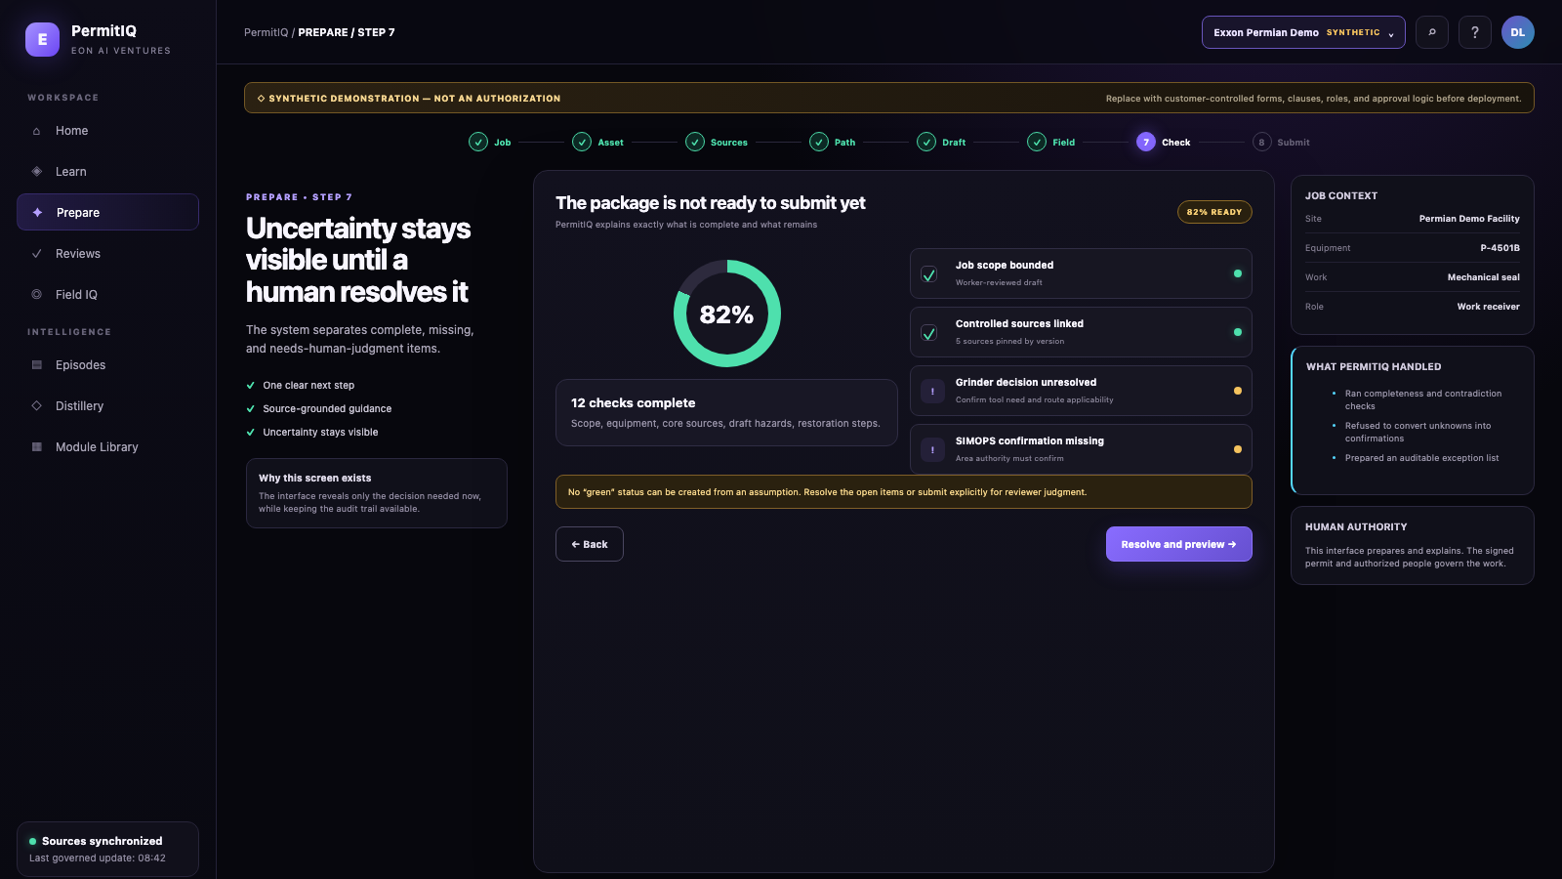

PERMITIQ UI WALKTHROUGH • SCREEN 12 OF 22
Uncertainty stays visible until it is resolved
PREPARE
SYNTHETIC UI DEMONSTRATION
Keep confirmed, unanswered, and blocked items separate before the package is submitted.
WHY IT MATTERS
No green score can hide a critical missing field fact.
EON AI VENTURES • PERMITIQ UI CONCEPT
SYNTHETIC DEMONSTRATION — REPLACE WITH CUSTOMER-CONTROLLED FORMS & SOURCES
12 / 22

Slide 14
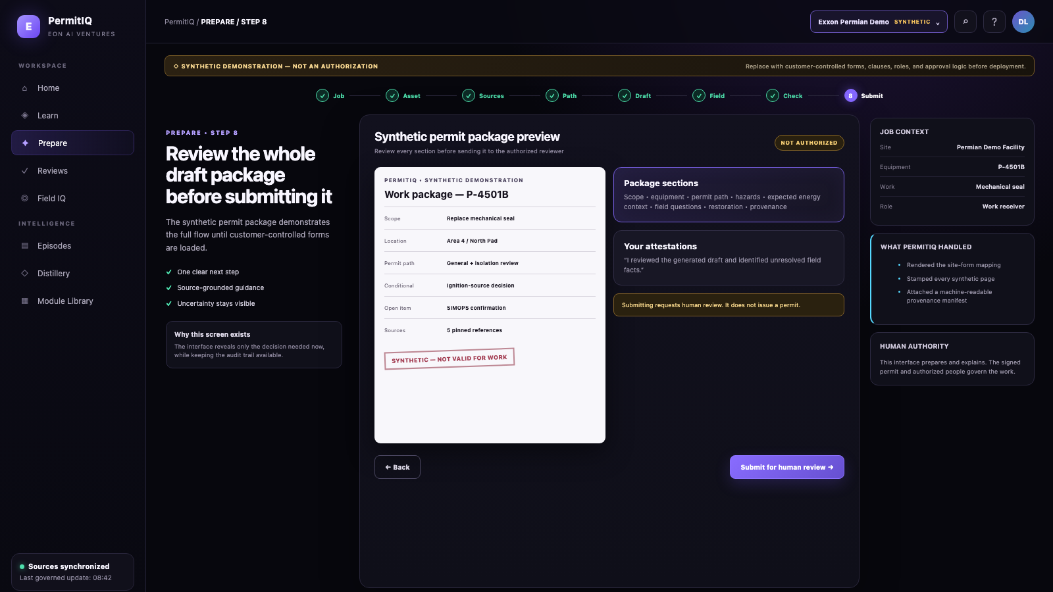

PERMITIQ UI WALKTHROUGH • SCREEN 13 OF 22
See the whole package before sending it
PREPARE
SYNTHETIC UI DEMONSTRATION
Review the draft, sources, open questions, and attestations together as one work story.
WHY IT MATTERS
Problems are corrected before they reach the permit issuer.
EON AI VENTURES • PERMITIQ UI CONCEPT
SYNTHETIC DEMONSTRATION — REPLACE WITH CUSTOMER-CONTROLLED FORMS & SOURCES
13 / 22

Slide 15
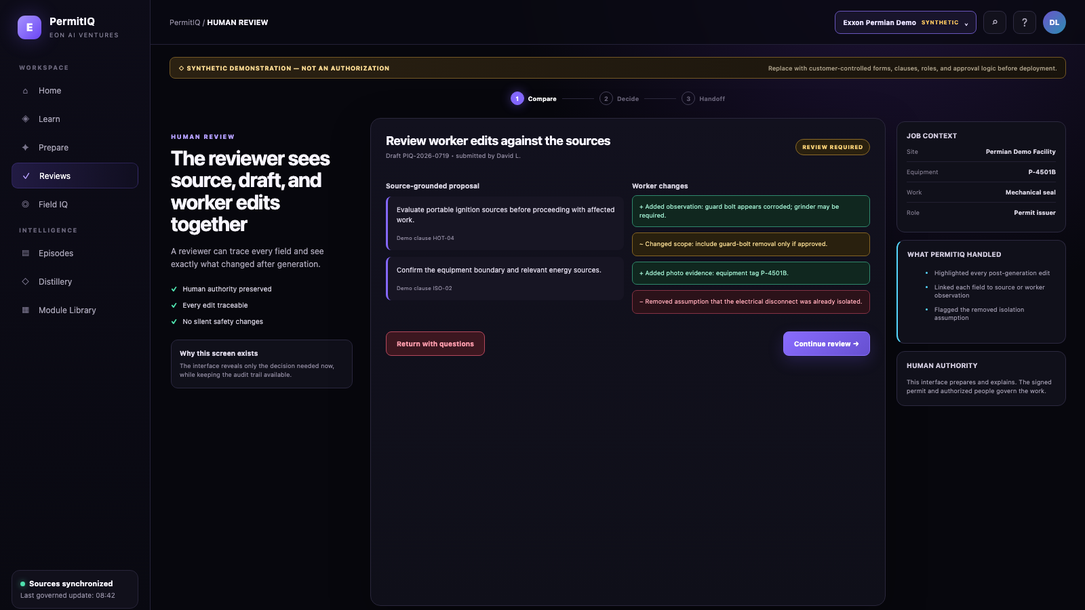

PERMITIQ UI WALKTHROUGH • SCREEN 14 OF 22
The reviewer sees every important change
REVIEW
SYNTHETIC UI DEMONSTRATION
Align source wording, PermitIQ’s draft, and the worker’s edits for fast comparison.
WHY IT MATTERS
Review is faster without losing source traceability.
EON AI VENTURES • PERMITIQ UI CONCEPT
SYNTHETIC DEMONSTRATION — REPLACE WITH CUSTOMER-CONTROLLED FORMS & SOURCES
14 / 22

Slide 16
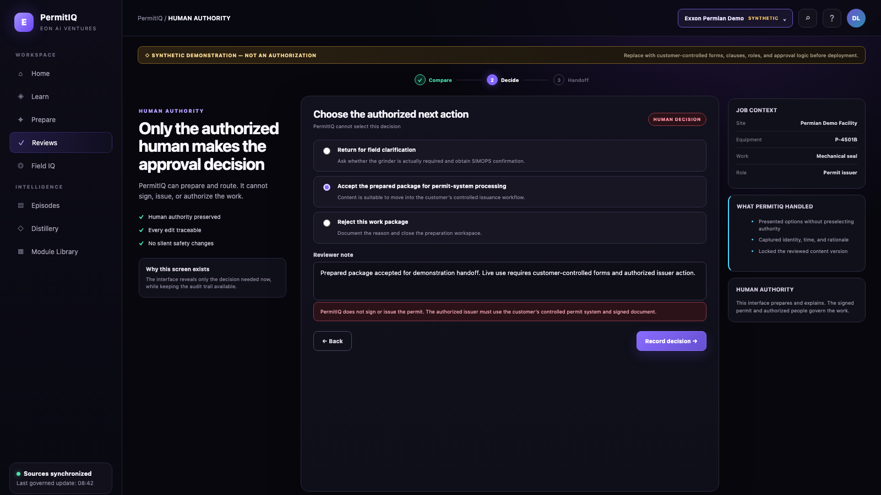

PERMITIQ UI WALKTHROUGH • SCREEN 15 OF 22
Only the authorized human makes the approval decision
REVIEW
SYNTHETIC UI DEMONSTRATION
The issuer can approve, return, or reject—and must record the reason for the decision.
WHY IT MATTERS
PermitIQ supports human authority; it never replaces it.
EON AI VENTURES • PERMITIQ UI CONCEPT
SYNTHETIC DEMONSTRATION — REPLACE WITH CUSTOMER-CONTROLLED FORMS & SOURCES
15 / 22

Slide 17
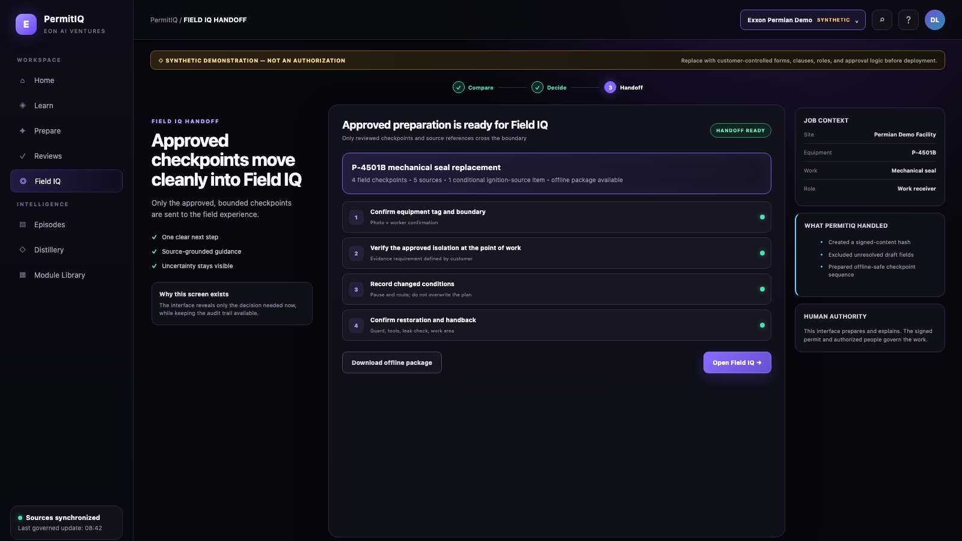

PERMITIQ UI WALKTHROUGH • SCREEN 16 OF 22
Only approved checkpoints move into the field
VERIFY
SYNTHETIC UI DEMONSTRATION
The approved permit package hands a precise list of physical checks to Field IQ.
WHY IT MATTERS
PermitIQ prepares the logic. Field IQ captures what was verified.
EON AI VENTURES • PERMITIQ UI CONCEPT
SYNTHETIC DEMONSTRATION — REPLACE WITH CUSTOMER-CONTROLLED FORMS & SOURCES
16 / 22

Slide 18
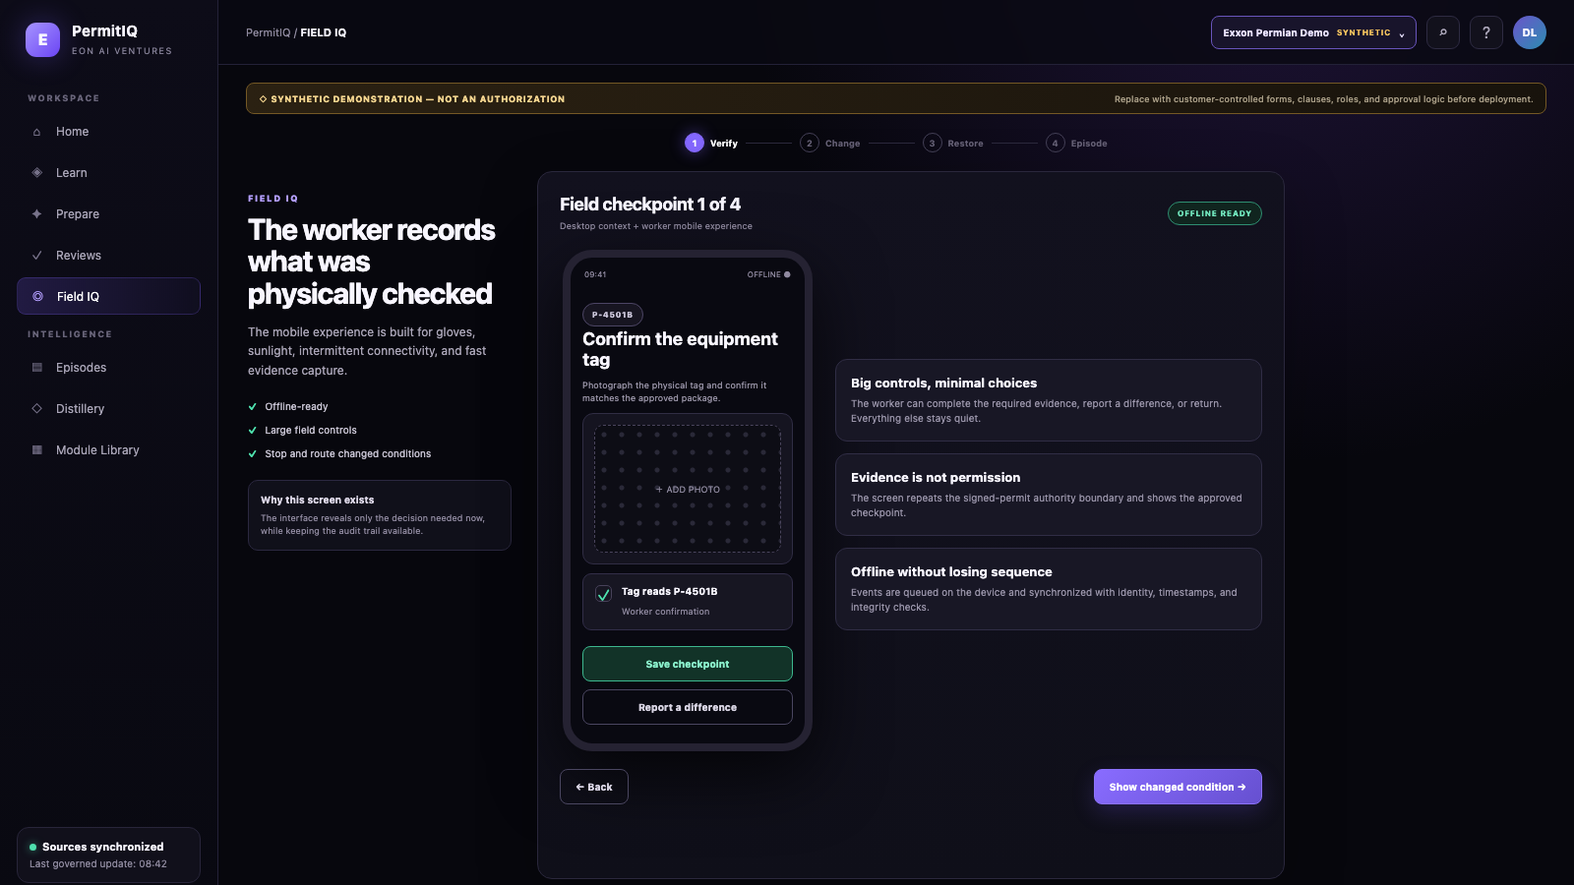
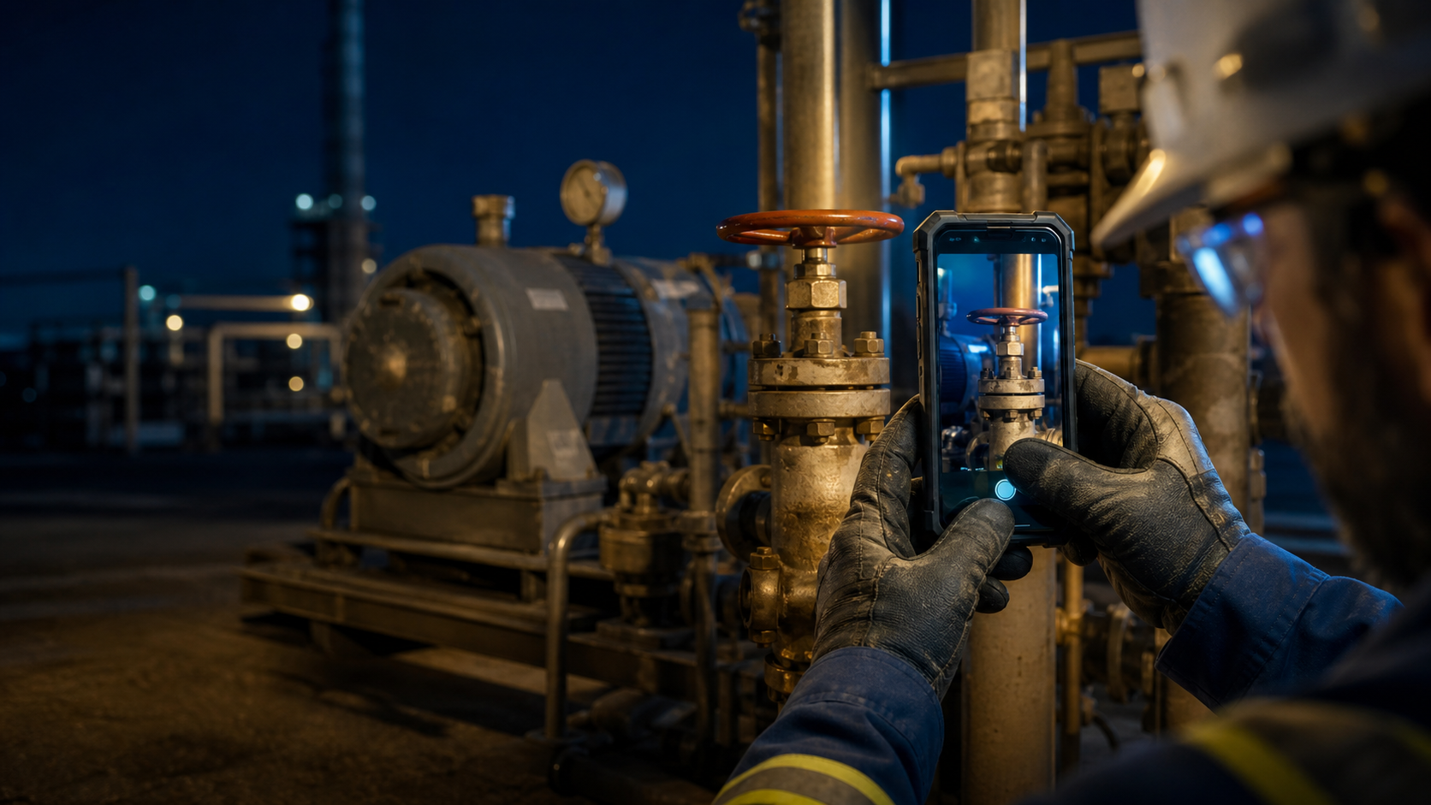
PERMITIQ UI WALKTHROUGH • SCREEN 17 OF 22
Record what was physically checked
VERIFY
SYNTHETIC UI DEMONSTRATION
Capture photos, observations, equipment identity, time, and user at the point of work.
WHY IT MATTERS
A checkbox becomes evidence tied to the real asset.
EON AI VENTURES • PERMITIQ UI CONCEPT
SYNTHETIC DEMONSTRATION — REPLACE WITH CUSTOMER-CONTROLLED FORMS & SOURCES
17 / 22

Slide 19
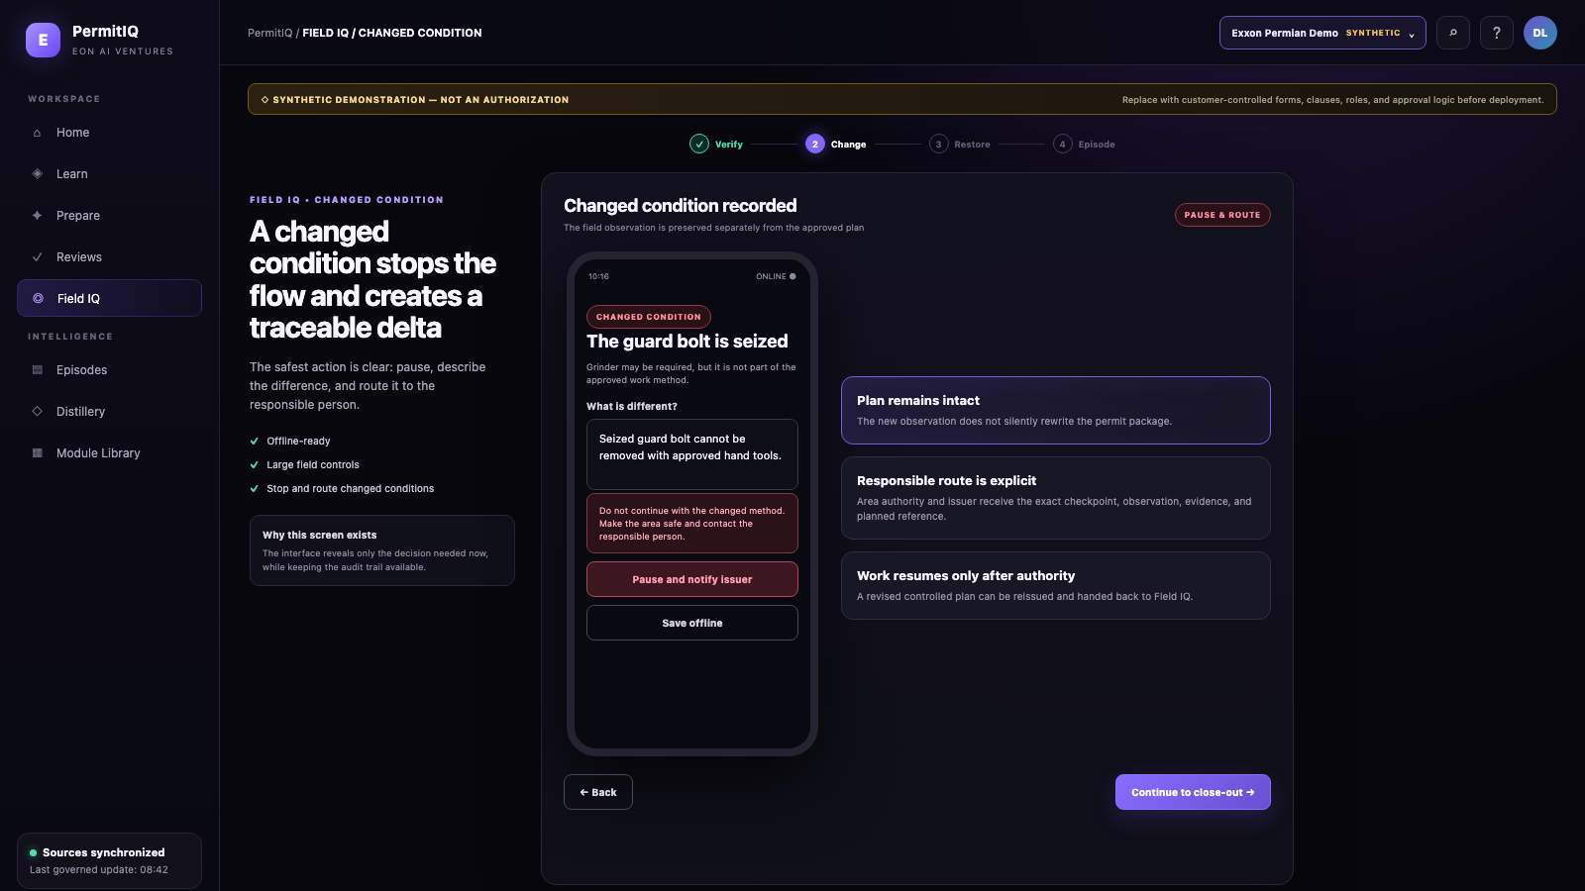

PERMITIQ UI WALKTHROUGH • SCREEN 18 OF 22
A changed condition stops the flow
VERIFY
SYNTHETIC UI DEMONSTRATION
If the field differs from the approved basis, raise a delta instead of working around it.
WHY IT MATTERS
The job pauses and returns for reassessment with a traceable record.
EON AI VENTURES • PERMITIQ UI CONCEPT
SYNTHETIC DEMONSTRATION — REPLACE WITH CUSTOMER-CONTROLLED FORMS & SOURCES
18 / 22

Slide 20
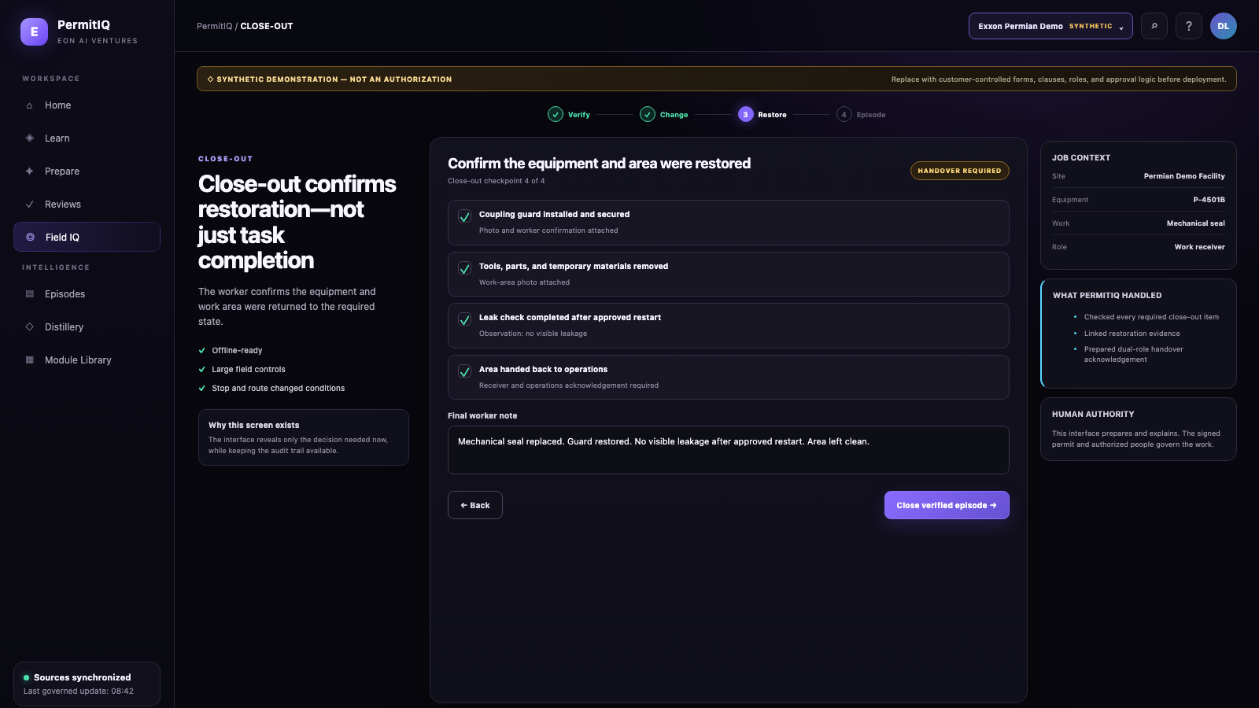

PERMITIQ UI WALKTHROUGH • SCREEN 19 OF 22
Restoration is part of the job
VERIFY
SYNTHETIC UI DEMONSTRATION
Verify guards, isolations, housekeeping, and handback before the episode can close.
WHY IT MATTERS
Record how safe conditions were restored—not just how work began.
EON AI VENTURES • PERMITIQ UI CONCEPT
SYNTHETIC DEMONSTRATION — REPLACE WITH CUSTOMER-CONTROLLED FORMS & SOURCES
19 / 22

Slide 21
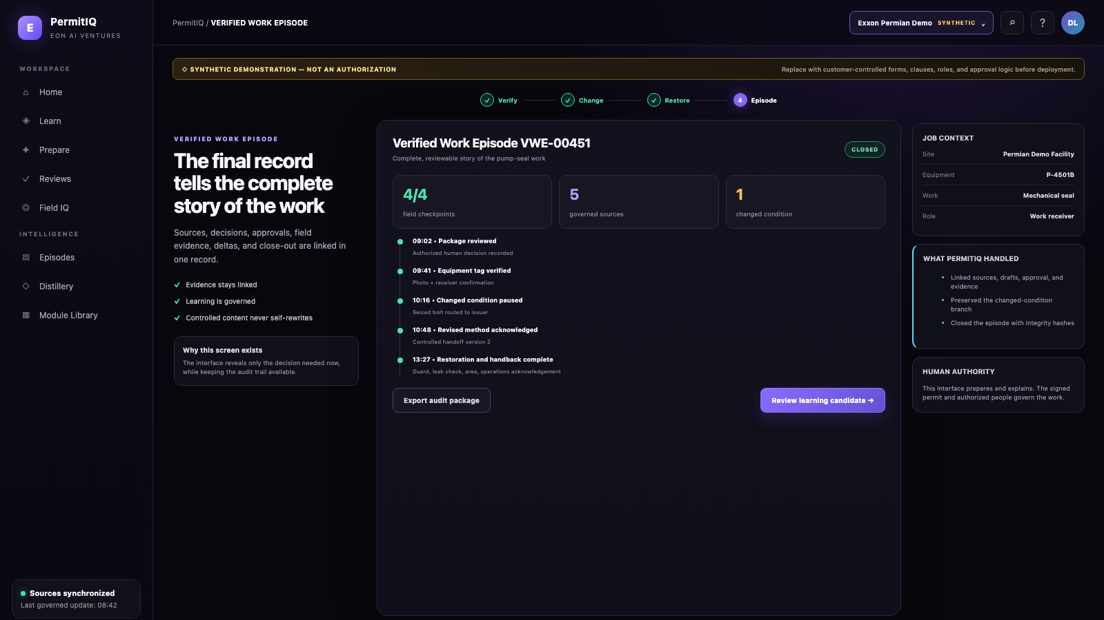

PERMITIQ UI WALKTHROUGH • SCREEN 20 OF 22
The final record tells the complete work story
RECORD
SYNTHETIC UI DEMONSTRATION
Intent, sources, decisions, approvals, evidence, deltas, and closeout become one verified episode.
WHY IT MATTERS
Understand what happened without reconstructing fragments.
EON AI VENTURES • PERMITIQ UI CONCEPT
SYNTHETIC DEMONSTRATION — REPLACE WITH CUSTOMER-CONTROLLED FORMS & SOURCES
20 / 22

Slide 22
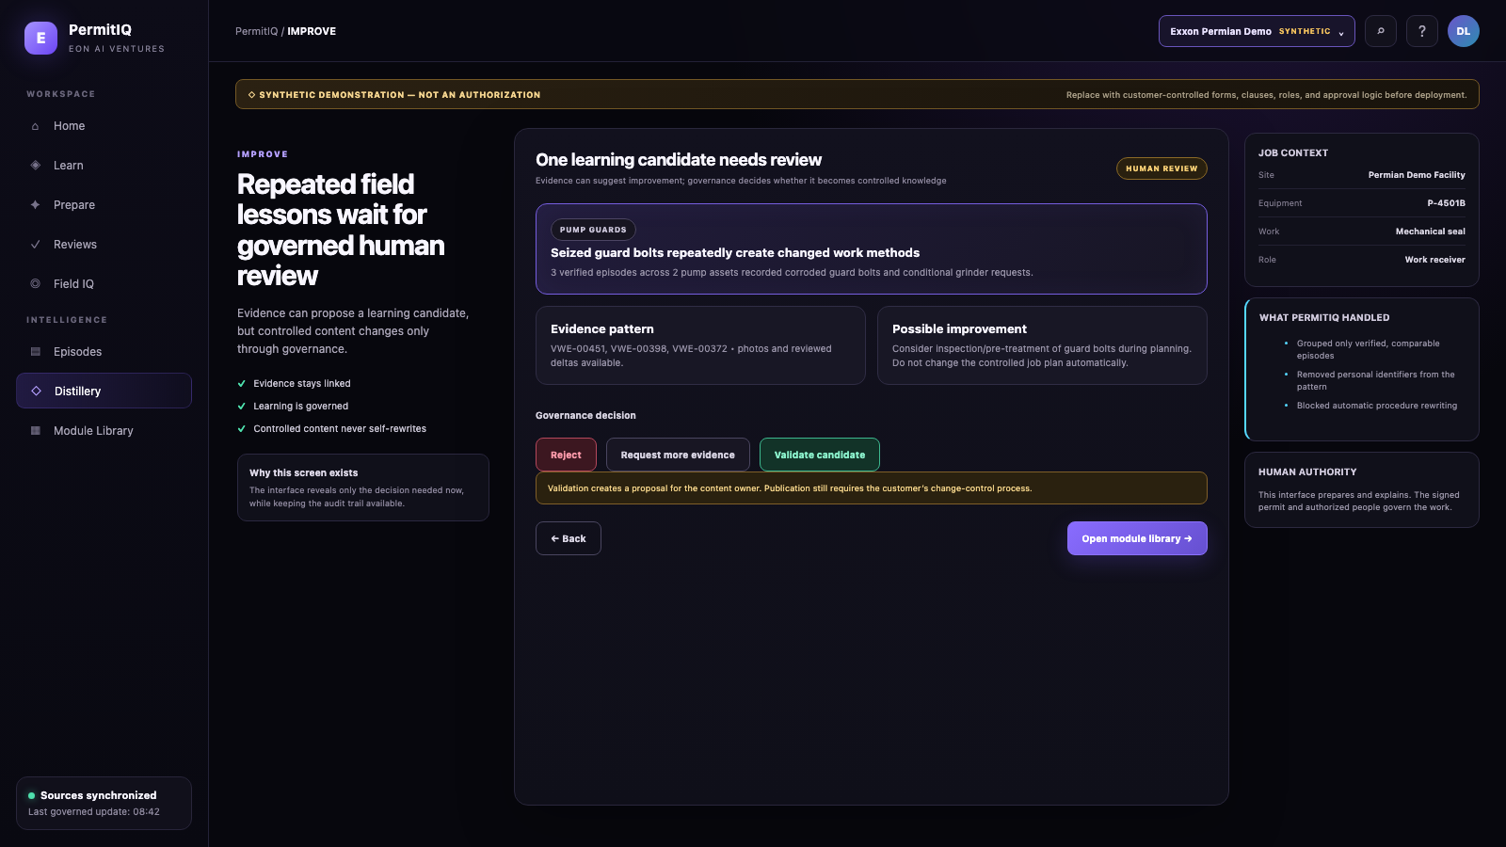
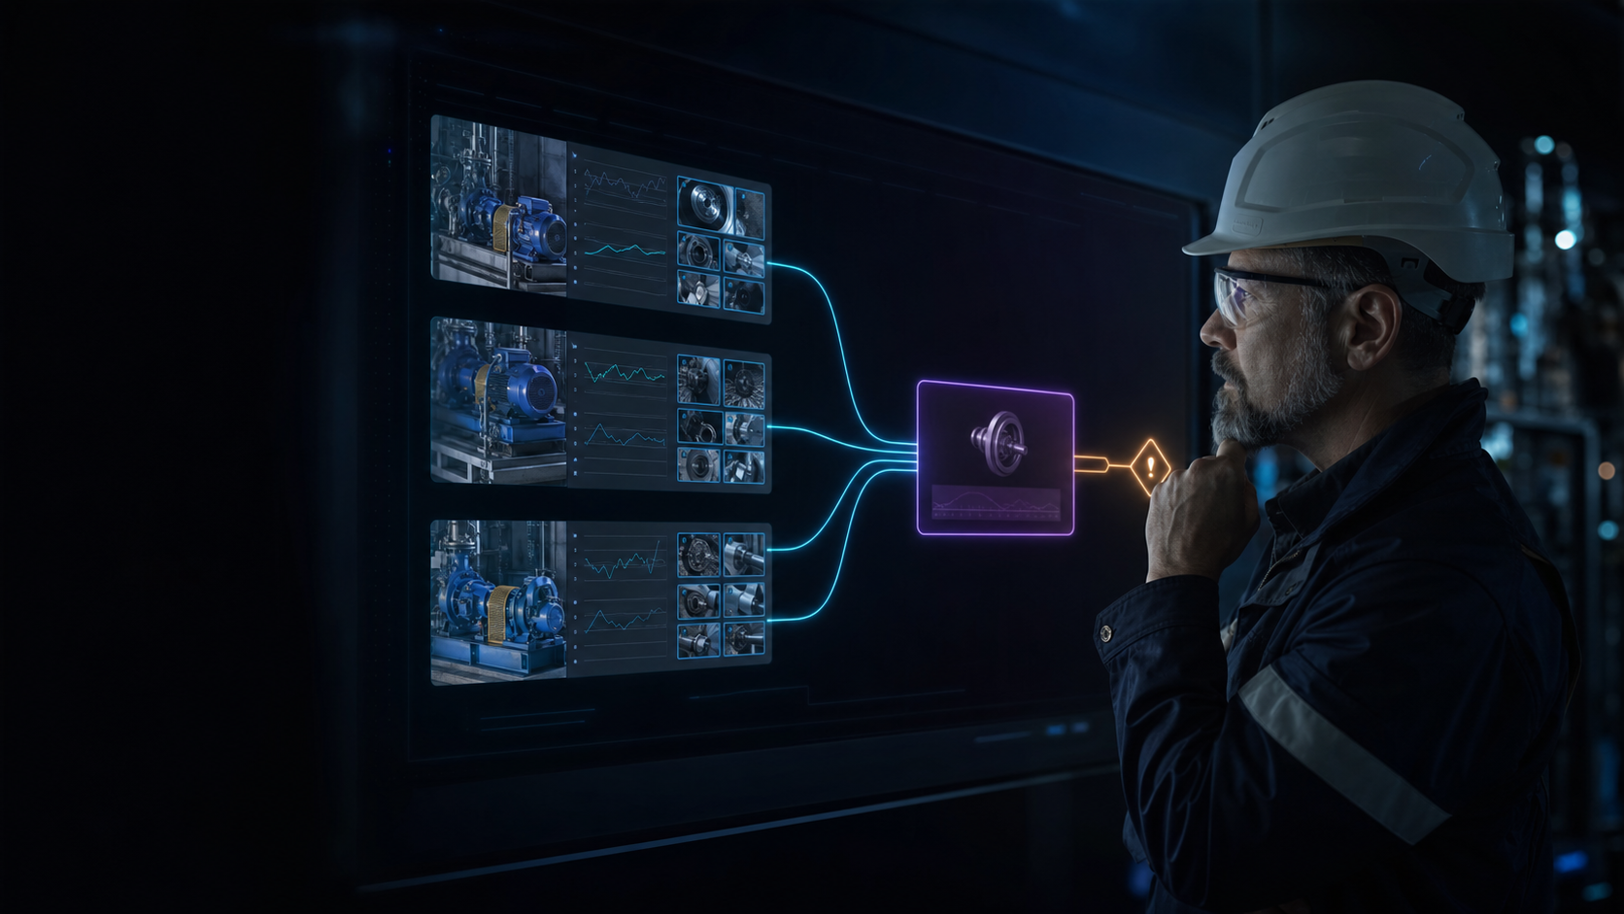
PERMITIQ UI WALKTHROUGH • SCREEN 21 OF 22
Repeated evidence can propose a better way
IMPROVE
SYNTHETIC UI DEMONSTRATION
Find patterns across verified episodes and create a governed improvement proposal.
WHY IT MATTERS
Evidence may propose change. A human owner must review and publish it.
EON AI VENTURES • PERMITIQ UI CONCEPT
SYNTHETIC DEMONSTRATION — REPLACE WITH CUSTOMER-CONTROLLED FORMS & SOURCES
21 / 22

Slide 23
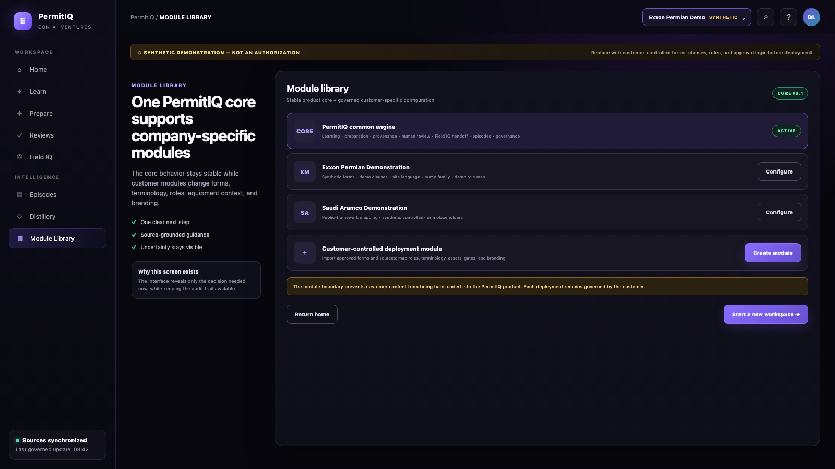

PERMITIQ UI WALKTHROUGH • SCREEN 22 OF 22
One core. Many company-specific governed modules.
SCALE
SYNTHETIC UI DEMONSTRATION
Forms, language, sources, roles, and workflows can change while the trusted core stays stable.
WHY IT MATTERS
Start with one customer, one facility, and one equipment family—then scale.
EON AI VENTURES • PERMITIQ UI CONCEPT
SYNTHETIC DEMONSTRATION — REPLACE WITH CUSTOMER-CONTROLLED FORMS & SOURCES
22 / 22

